Slide 1

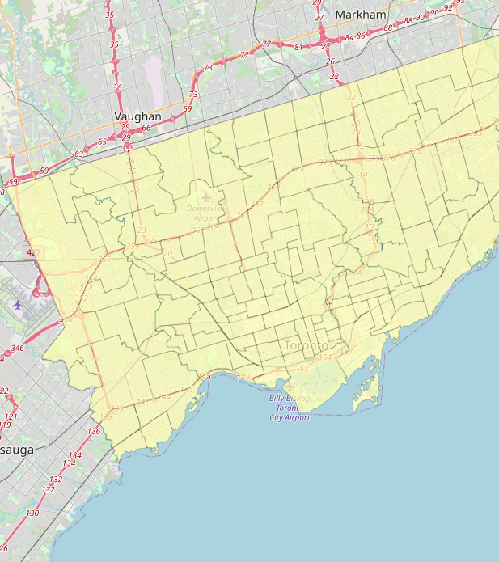

Most Affordable Homing in Toronto

Slide 2
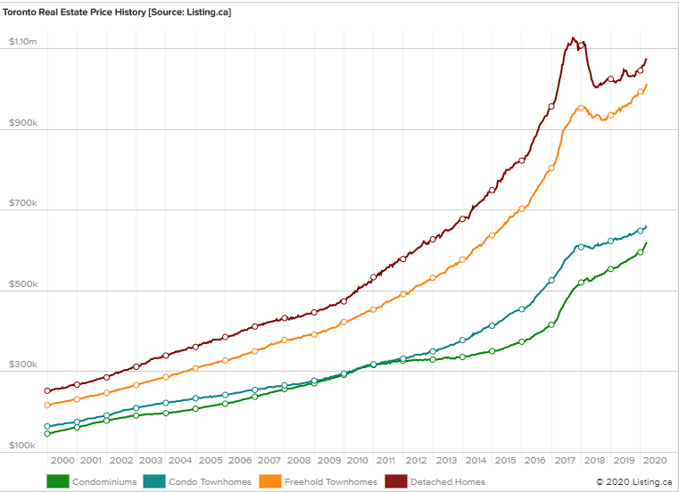
History of House Prices in Toronto
Houses don’t come at a cheap price, and it is usually a long-term investment.
The cost of houses in Toronto in 1985 was $109,094.
In 2015, that number rose to $566,696.
In February 2020, the cost of the same house is $852,900, growing a whopping 60% in the past 5 years.
Selecting the right house is a very important decision and it would be better if the person lives in the neighborhood where whatever they want is at their disposal and the price of his house is affordable.

Slide 3

Problem
Categorize the neighborhoods based on the venues and services around it and choose the best neighborhood according to the affordability of the houses and the venues available around it.

Slide 4
Data Acquisition and Cleaning
The housing price of the neighborhoods (HOUSES) in Toronto were obtained from here
The coordinates of the neighborhoods (LOCATION) in Toronto were obtained from here.
Foursquare was used to get the data of the venues in the neighborhoods.
In total, there were 542 house price values in 140 Neighborhoods
8957 Venues and 353 Venue Categories were found across 140 Neighborhoods according to Foursquare

Slide 5
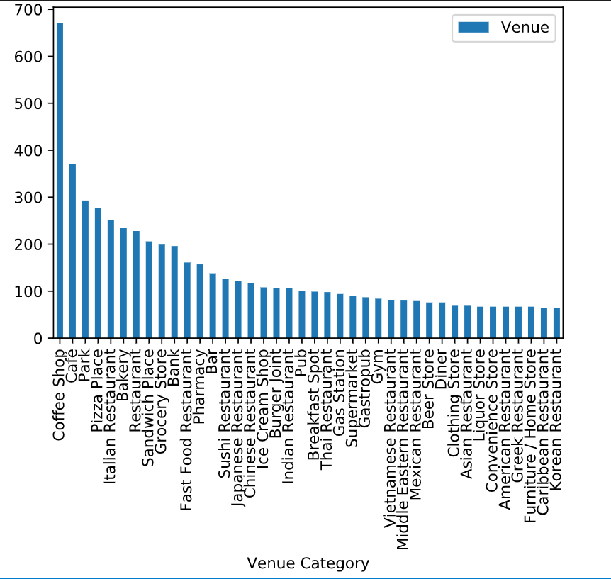
Total Number of Venues in Each Category

Slide 6
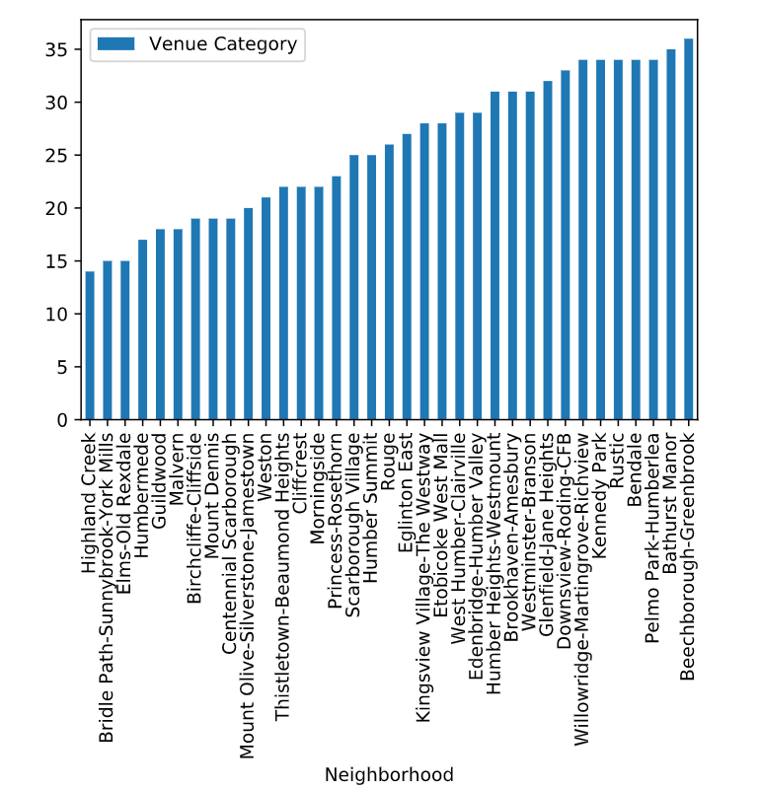
Venue Categories in each Neighborhood

Slide 7
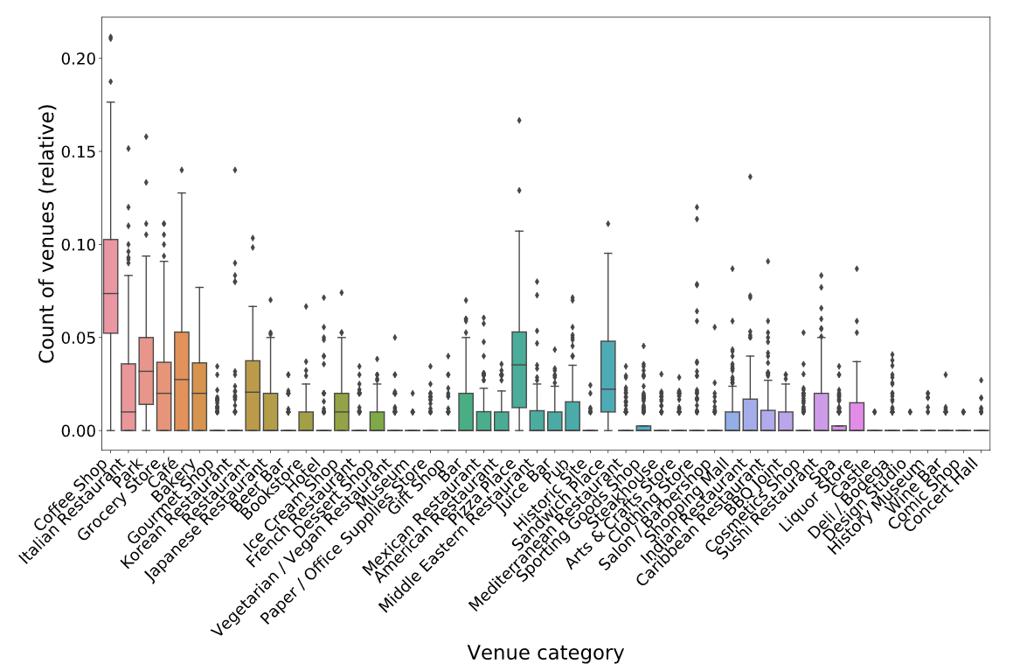
Distribution of the categories in the Neighborhoods

Slide 8

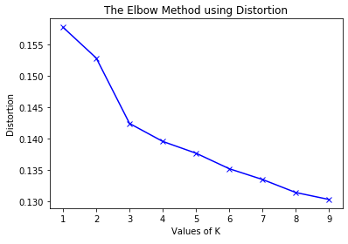
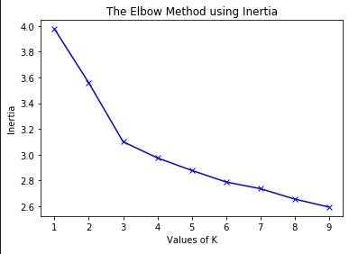
Clustering: Finding the optimum K value

Slide 9
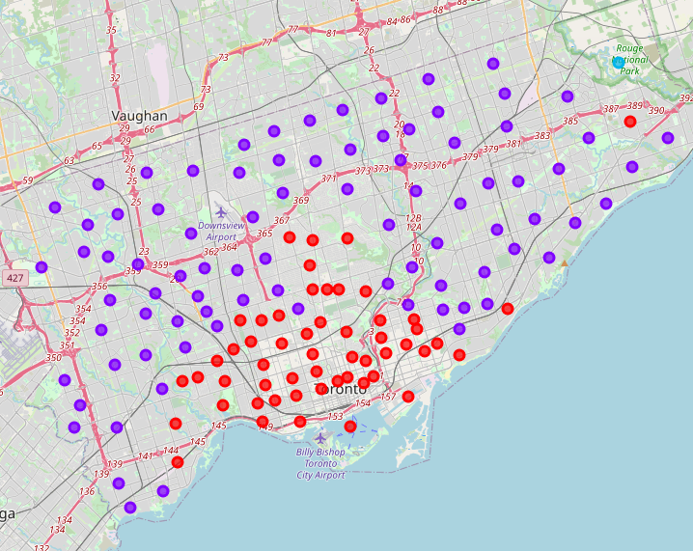
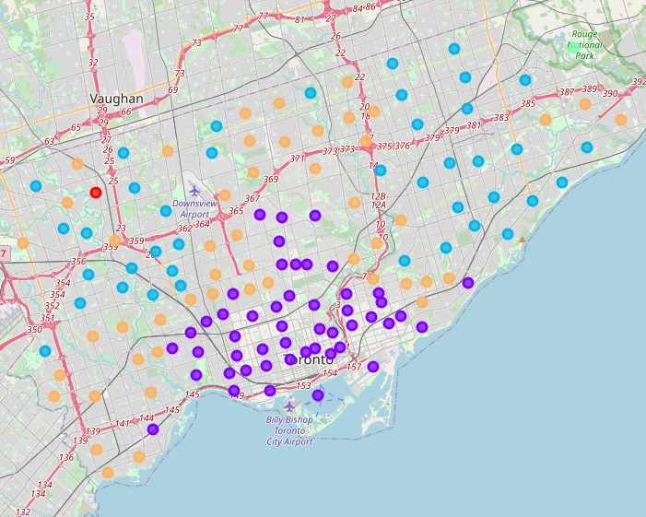
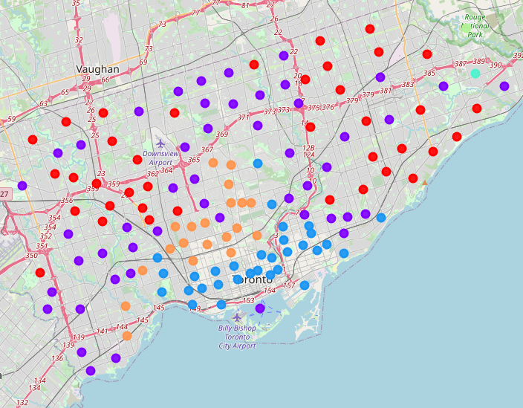
Clustering: Map of Toronto with 3 different K values
K = 3
K = 5
K = 6

Slide 10
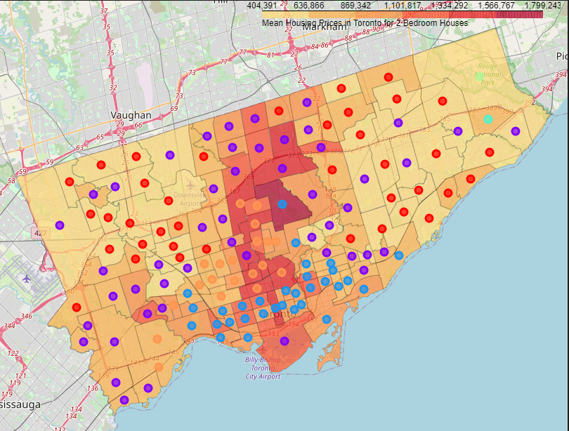
Mean Housing Price for 2 Bedroom Houses with the Clusters

Slide 11
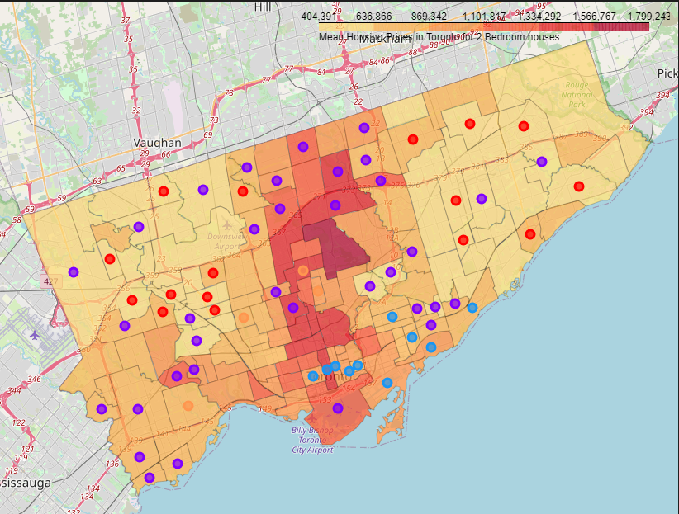
Neighborhoods where Pizza Place or Coffee Shops are most Popular

Slide 12
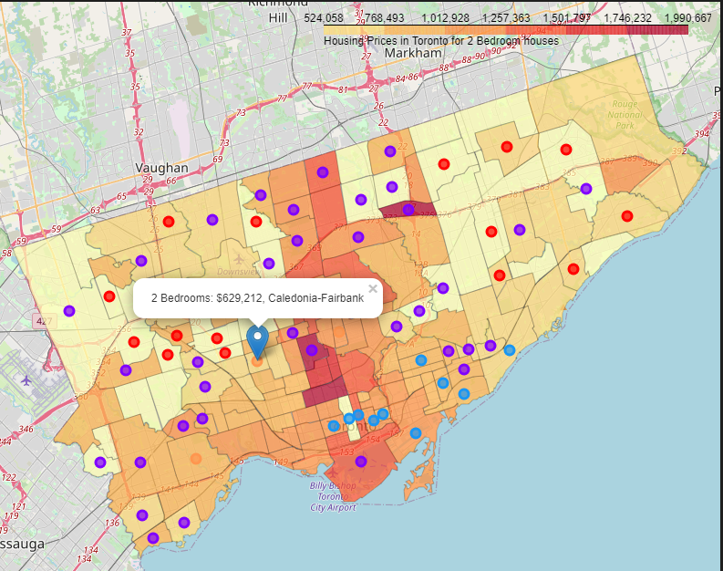
Lowest House Price (of all 4 House Types) of Cluster 5 where Coffee Shop or Pizza Place is the most popular

Slide 13

Conclusion and Future Direction
Built useful models for the neighborhoods in Toronto according to the Venue Categories in the neighborhood
Created a visual representation of the housing prices in Toronto using Choropleth map
Found the most affordable housing based on the person’s liking and the housing price in the neighborhood
Ideas include:
Divide the maps by house types
Include the desired venue from the Top 5 Categories (Not just from the top one)
Include other factors like safety, traffic, pollution, venue rating, distance from work etc. to find the best neighborhood

